Slide 1
INFO1112 Tutorial
Week 2

Slide 2






Attendance
https://bit.ly/47dHbjx

Slide 3
A few housekeeping announcements
Homework 1 – due Sunday 13th August 23:59:00 (this Sunday)
Most tasks can be completed with knowledge from lectures/labs
If in doubt:
Google for a general solution (be careful not to copy-paste a solution – ensure you can adapt a solution to your needs)
Use the man pages for a command
As homework is assessed task, please ensure you work on this individually

Slide 4
Brief summary of this week’s content

Slide 5
2.1 –The Shell
Special program to interpret character strings and execute programs/perform some action
Many different types of shells developed
Most commonly used (and used by this course for scripts): Bash (Bourne Again Shell)
Others include zsh (default shell on macOS), csh, ksh
Functions the shell can do:
Execute programs (with specific arguments)
Look around, move within, and interact with the namespace
Has special syntax to do more powerful actions
Makes the shell function as a regular programming language
More on this in future weeks

Slide 6
2.1 – The Shell
Shell can store variables like other programming languages
To assign: $ NAME=chris
To view contents of a variable: $ echo $NAME
Dollar sign in front of string indicates we want to access a variable
Important: shells can only store strings, or arrays of strings as variables
To interpret as another data type, use the shell to run a program which can do so (e.g. expr)
To use the output of one command somewhere else, use backticks (`) around command
E.g. – for the variable VALUE to store 2 + 2, we can do
$ VALUE=`expr 2 + 2`
Alternative for Bash/modern shells: wrap command with $(), e.g.
$ VALUE=$(expr 2 + 2)

Slide 7
2.1 – The Shell
Multiple commands can be stored in file called shell script
Parts of shell script:
what program to interpret the script with with shebang: #!
E.g. #!/bin/bash
commands to run
Run shell script by:
specifying shell to run script: $ bash myscript.sh
In this case, shebang is seen as comment and ignored
making script executable, then running it directly: $ ./myscript.sh
Shell script has special variables:
$0, $1, … – arguments passed to script ($0 is the script name)
$@ – all arguments passed to script as array

Slide 8
2.1 – The Shell
Command | Description | Example
> | Redirects output to a file, Creates one if it does not exist, Overrides if it does | echo hello > myfile.txt
>> | Redirects and appends output to a file | echo world >> myfile.txt
< | Redirects contents from file to stdin of another command | grep hello < myfile.txt
2> | Redirects stderr to a file | gggrep hi myfile.txt 2> errors.txt
‘Redirection’
How to store output

Slide 9
2.1 – The Shell
Can use output of one command as input of another command through pipes (|)
Takes stdo from first command, and uses this as stdin for second command
E.g. $ ls | grep “Do” takes output from ls and uses this as input content for grep
What would this match if I ran it in my home folder (with folders Documents, Pictures, Music, Downloads)?
Very useful for combining commands together to produce desired output

Slide 10
2.2 – Processes
Unix system usually has many processes stored in memory at same time
For a single CPU, only one program can run at a time
Not feasible for most computing
Kernel uses interrupt to save state of program to continue execution later
Combination of all memory used by a program and its current state is called process
Use ps command to find out information about processes
Each process has an associated user ID (UID) of who started the process
On most Unix systems (including Linux), UID is mapped to a name in /etc/passwd file
macOS uses alternative called Open Directory (beyond scope of course)
/etc/passwd entry includes UID, user name, home folder, and what shell the user uses

Slide 11
2.2 – Processes
Each user is part of at least one associated group, which each have their own group IDs (GIDs)
/etc/group maps GIDs to group names, and contains users part of the group (macOS is an exception – not all users are listed)
UID of 0 refers to superuser
Privileged user who can access any file, run any program, and kill any running program
System files are owned by the superuser to prevent tampering
Username is usually ”root”
On many systems, can temporarily escalate your privilege to superuser with programs like sudo
Be careful: with great power, comes great responsibility!

Slide 12
In Unix systems, files have associated metadata
Can be seen by running ls –l
type of file (- = normal file, d = directory, l = link b = block file)
permissions (r = readable, w = writable, x = executable (for files)/accessible (for directories)) – listed as [r/-][w/-][x/-] for each group, where - means permission doesn’t exist
user permissions
group permissions
permissions for users in other groups
total 16
drwxr-xr-x 4 chris staff 128 28 Jul 23:47 Official Documents
drwxr-xr-x 4 chris staff 128 28 Jul 23:03 Programming
drwxr-xr-x 3 chris staff 96 10 Aug 10:05 Uni
drwxr-xr-x 4 chris staff 128 25 Jul 21:06 Work
-rwxr-xr-x 1 chris staff 71 11 Aug 13:18 myscript.sh
-rw-r--r-- 1 chris staff 0 11 Aug 13:19 output.txt
-rw-r--r-- 1 chris staff 12 11 Aug 13:17 test.txt

Slide 13
2.2 – Processes
total 16
drwxr-xr-x 4 chris staff 128 28 Jul 23:47 Official Documents
drwxr-xr-x 4 chris staff 128 28 Jul 23:03 Programming
drwxr-xr-x 3 chris staff 96 10 Aug 10:05 Uni
drwxr-xr-x 4 chris staff 128 25 Jul 21:06 Work
-rwxr-xr-x 1 chris staff 71 11 Aug 13:18 myscript.sh
-rw-r--r-- 1 chris staff 0 11 Aug 13:19 output.txt
-rw-r--r-- 1 chris staff 12 11 Aug 13:17 test.txt
User who owns the file
Group of user who owns the file
File size (in bytes)
Date last modified

Slide 14

2.2 – Processes
Going back to the concept of the namespace in Unix
Namespace generally contains the file system of all files/directories stored on the disk
Namespace can also contain devices, which are accessible in the same way files usually are
Usually, block (storage) devices are located under the /dev directory
On Linux, the /proc directory contains special ”pseudo” files
These look like regular files, but contain live, updated information on the computer system
Created and served by special driver files

Slide 15
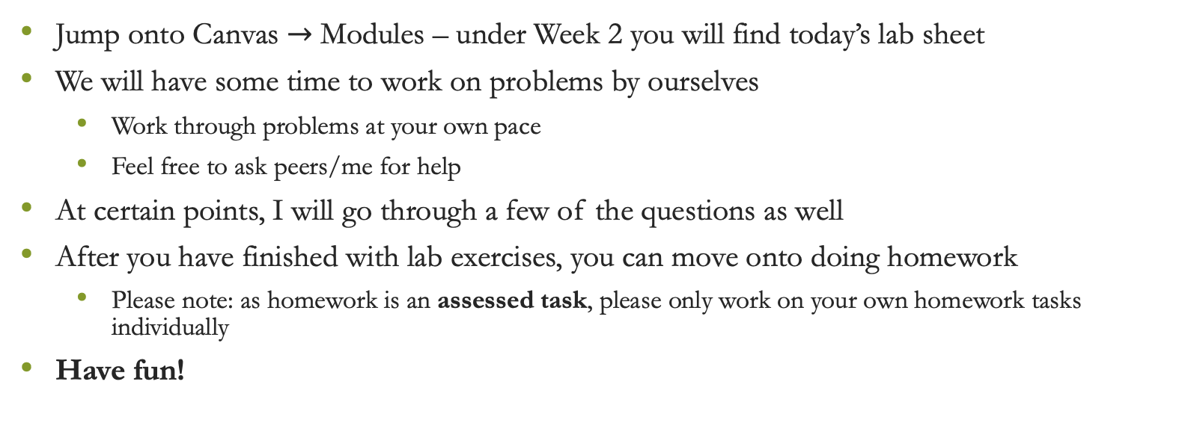
Lab exercises
Jump onto Canvas $→$ Modules – under Week 2 you will find today’s lab sheet
We will have some time to work on problems by ourselves
Work through problems at your own pace
Feel free to ask peers/me for help
At certain points, I will go through a few of the questions as well
After you have finished with lab exercises, you can move onto doing homework
Please note: as homework is an assessed task, please only work on your own homework tasks individually
Have fun!

